Slide 1
Mind the App
Application Development as a Solution to Unmet Needs in Laboratory Workflows
Amrom Obstfeld MD PhD
Medical Director of Pathology Informatics

Slide 2
Disclosures
None

Slide 3

Dr. Daniel Holmes MD, FRCPC
Clinical Professor,
Division Head, Clinical Chemistry,
St. Paul’s Hospital

Slide 4
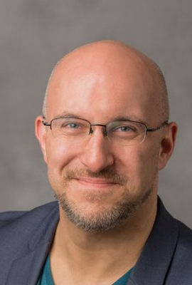
Stephan Kadauke, MD, PhD
Assistant Director, Cell and Gene Therapy Laboratory
Lead, CGT DataOps Team
Children's Hospital of Philadelphia
Notes:
Dr. Kadauke is board certified in Clinical Pathology and Transfusion Medicine and serves as the Assistant Director of the Cell and Gene Therapy Lab of the Children’s Hospital of Philadelphia.
He also leads the Cell and Gene Therapy Data Operations group, which aims to improve the care of children who receive Bone Marrow Transplants and other Cell and Gene Therapies.
Dr. Kadauke developed a curriculum in Reproducible Clinical Data Analysis tailored for physicians and other healthcare professionals.

Slide 5
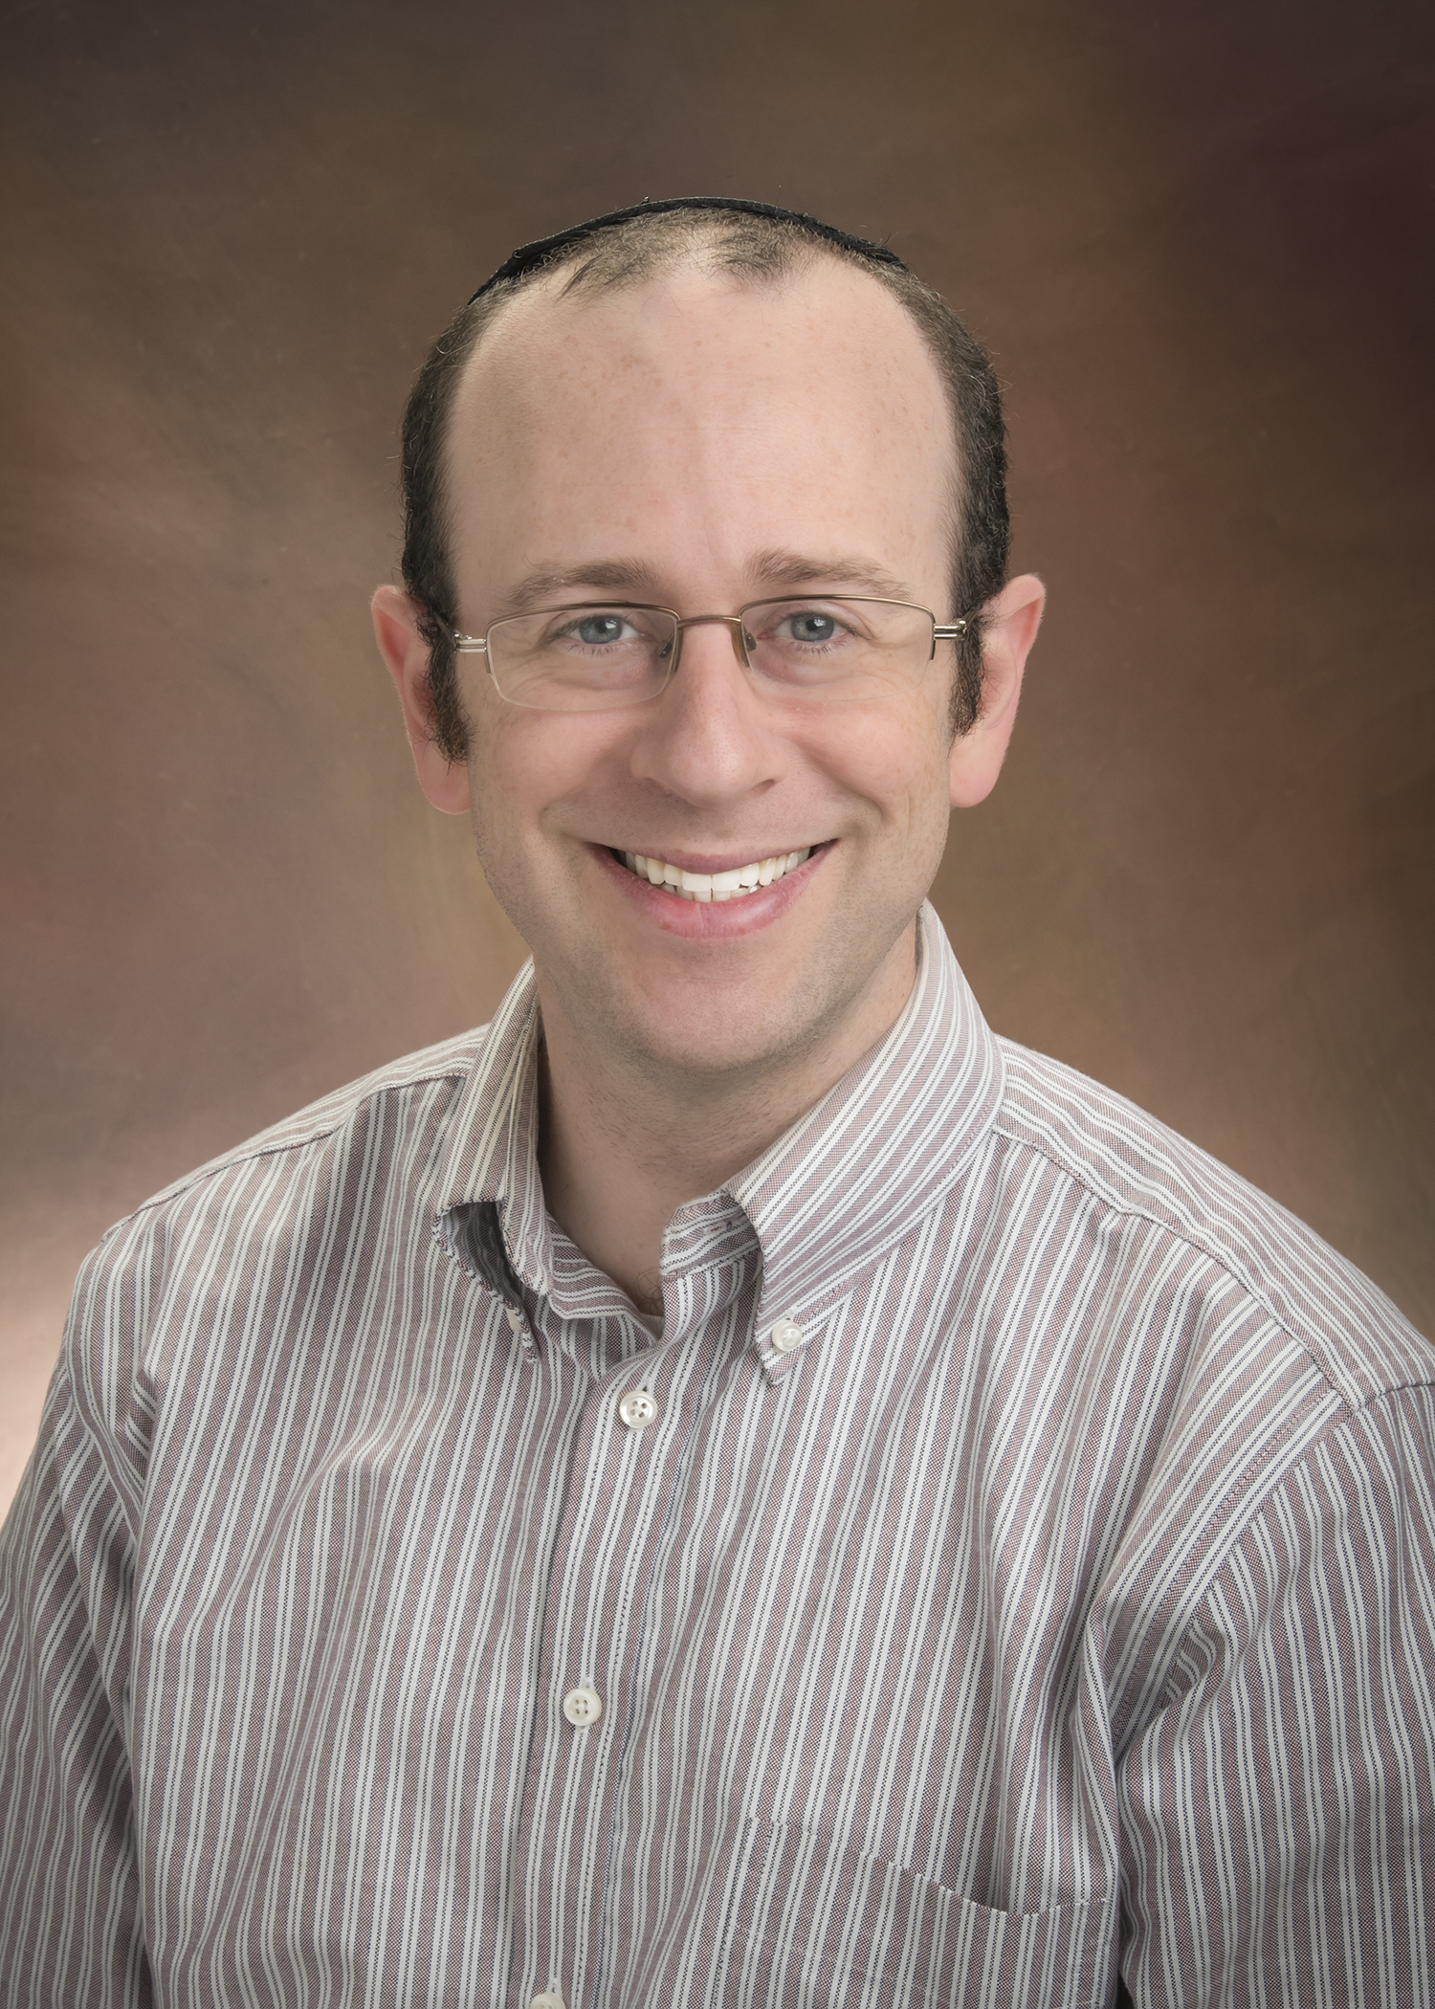
Amrom Obstfeld, MD, PhD
Director, Pathology Informatics
Department of Pathology and Laboratory Medicine
Children's Hospital of Philadelphia

Slide 6
Outline
Why Custom App Development for Your Lab?
- Amrom Obstfeld MD PhD
Why Use R and What Kinds of Apps Can I Make?
- Daniel T Holmes MD, FRCPC
Making Reliable Lab Apps: Demystifying Good Software Engineering Practices
- Stephan Kadauke MD PhD
Notes:
Should I be doing formal introductionis??

Slide 7
Learning Objectives
Describe the value provided by investing in custom app development
List three challenges associated with using custom applications in clinical workflows
Describe ways in which these challenges can be mitigated by adhering to appropriate software development practices.

Slide 8





Do you get frustrated by limitations in your laboratory system?
A LOT!
Sometimes
Nope
Notes:
Multiple choice template #2

Slide 9

If so – What do you do about it?
Get Angry
Manual Process
Wait for LIS to improve
Develop Custom App
Notes:
Multiple choice template #2

Slide 10

The Brain of the Modern Clinical Laboratory
Accession
Quality Control
Orders
Asset tracking
LIS
Results
Automation
Test Dictionary
Instrument Driver
Notes:
Accessioning
Orders
Results
Test
Instrumentation
Automation
Asset tracking
Quality Control

Slide 11
The Brain of the Modern Clinical Laboratory
Accession
Peopleware
Quality Control
Orders
Instruments
Middleware
Asset tracking
LIS
Results
Automation
Test Dictionary
Instrument Driver
Notes:
Accessioning
Orders
Results
Test
Instrumentation
Automation
Asset tracking
Quality Control

Slide 12
The Brain of the Modern Clinical Laboratory
Accession
Accession
Quality Control
Orders
Quality Control
Orders
Instruments
Middleware
Asset tracking
LIS
Results
Asset tracking
LIS
Results
Automation
Test Dictionary
Instrument Driver
Automation
Test Dictionary
Instrument Driver
Notes:
Consider changing to puzzle metaephor

Slide 13




Why do these gaps arise?
Interfaces lead to "language barriers"
LIS are designed for the 80%
Specialty labs not compatible with LIS design
?
No useful lab system available

Slide 14
Closing the Functionality Gap
Accession
Accession
Accession
Quality Control
Orders
Quality Control
Orders
Quality Control
Orders
Instruments
Middleware
Asset tracking
Results
Asset tracking
Results
LIS
LIS
Asset tracking
LIS
Results
Automation
Test Dictionary
Automation
Test Dictionary
Automation
Test Dictionary
Hire staff
Do Nothing
Technology
Instrument Driver
Instrument Driver
Instrument Driver
Notes:
Technology = Reproducibility and Automation

Slide 15
vs
Technology
Buy
Build
Functionality gap is remedied by off the shelf solution from 3rd party vendor or LIS vendor
Lab produces a custom home-grown app or system to meet workflow needs
Notes:
Strengths Weaknesses
Buy O the shelf solution without the need
for continued support by laboratory sta
• New system is just as likely to have gaps
• Laboratory is unlikely to receive support on par with that
from within the department
Build Fit for purpose custom solution with
potential to grow to evolve with the
laboratory
• Coding not a common skillset in laboratory personnel
• Laboratory “owns” the continued maintenance of the
soware to ensure

Slide 16
vs
Buy
Build
Well supported off the shelf solution without the need for ongoing lab support
Custom solution with potential to grow with the laboratory
Strengths
Contracting
New systems can have gaps too
• Not customizable
Weakness
Coding not a common skillset in laboratory personnel
"Risky" lab owns the continued maintenance
Notes:
Lack of customizability
Contracting and implementation process can be lengthy
Upgrades and bug fixes may not be prioritized
Strengths Weaknesses
Buy O the shelf solution without the need
for continued support by laboratory sta
• New system is just as likely to have gaps
• Laboratory is unlikely to receive support on par with that
from within the department
Build Fit for purpose custom solution with
potential to grow to evolve with the
laboratory
• Coding not a common skillset in laboratory personnel
• Laboratory “owns” the continued maintenance of the
soware to ensure

Slide 17
Buy
Well-supported
off the shelf solution without the need for ongoing lab support
But for how long??
Well-supported
Except for build, configuration…
off the shelf solution
Notes:
Lack of customizability
Contracting and implementation process can be lengthy
Upgrades and bug fixes may not be prioritized
Strengths Weaknesses
Buy O the shelf solution without the need
for continued support by laboratory sta
• New system is just as likely to have gaps
• Laboratory is unlikely to receive support on par with that
from within the department
Build Fit for purpose custom solution with
potential to grow to evolve with the
laboratory
• Coding not a common skillset in laboratory personnel
• Laboratory “owns” the continued maintenance of the
soware to ensure

Slide 18
vs
Buy
Build
Well supported off the shelf solution without the need for ongoing lab support
Fit for purpose custom solution with potential to grow with the laboratory
Strengths
Contracting
New systems can have gaps too
• Not customizable
Weakness
Coding not a common skillset in laboratory personnel
"Risky" lab owns the continued maintenance
Notes:
Lack of customizability
Contracting and implementation process can be lengthy
Upgrades and bug fixes may not be prioritized
Strengths Weaknesses
Buy O the shelf solution without the need
for continued support by laboratory sta
• New system is just as likely to have gaps
• Laboratory is unlikely to receive support on par with that
from within the department
Build Fit for purpose custom solution with
potential to grow to evolve with the
laboratory
• Coding not a common skillset in laboratory personnel
• Laboratory “owns” the continued maintenance of the
soware to ensure

Slide 19
Build
Open-Source
Coding not a common skillset in laboratory personnel
"Risky" lab owns the continued maintenance
Coding not a common skillset in laboratory personnel
Notes:
Risk management
Fire
Strengths Weaknesses
Buy O the shelf solution without the need
for continued support by laboratory sta
• New system is just as likely to have gaps
• Laboratory is unlikely to receive support on par with that
from within the department
Build Fit for purpose custom solution with
potential to grow to evolve with the
laboratory
• Coding not a common skillset in laboratory personnel
• Laboratory “owns” the continued maintenance of the
soware to ensure

Slide 20
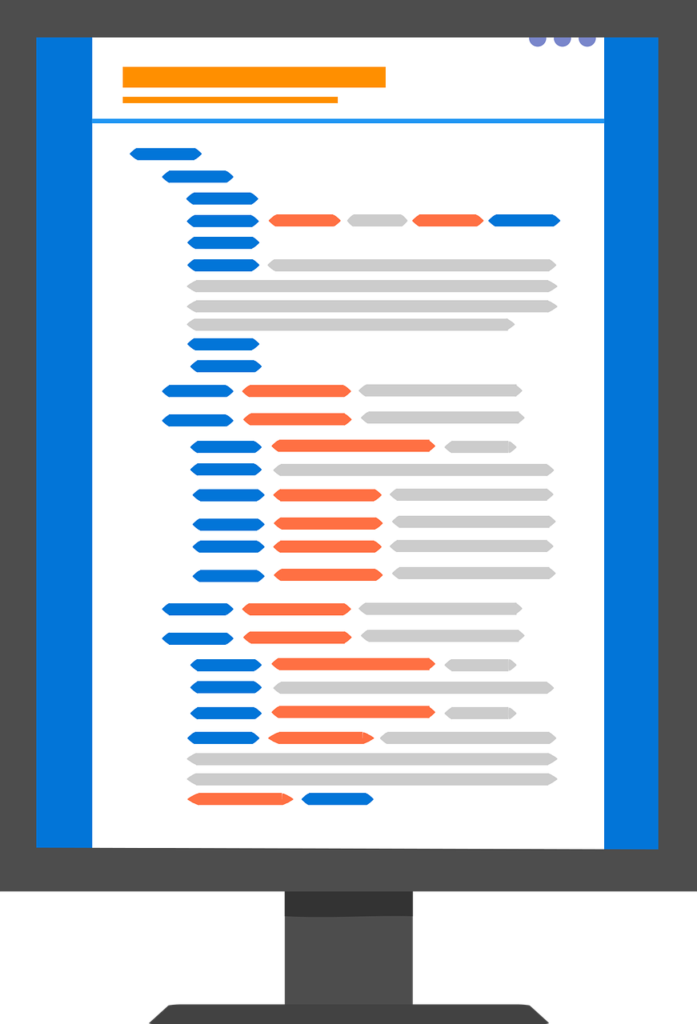


Open-Source
Freely available
Source code is distributed with program
Free to share
Anyone can share with anyone else
Free to modify
Users can make changes as needed
Free to improve
New features can be added and distributed

Slide 21
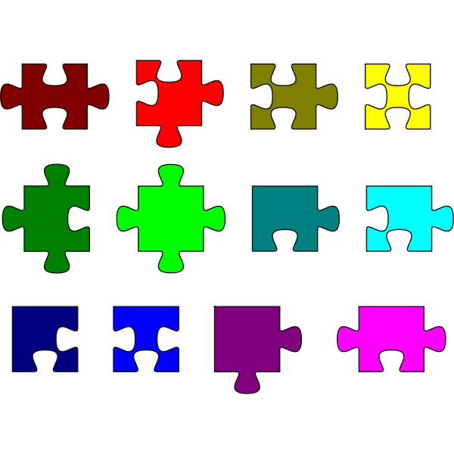
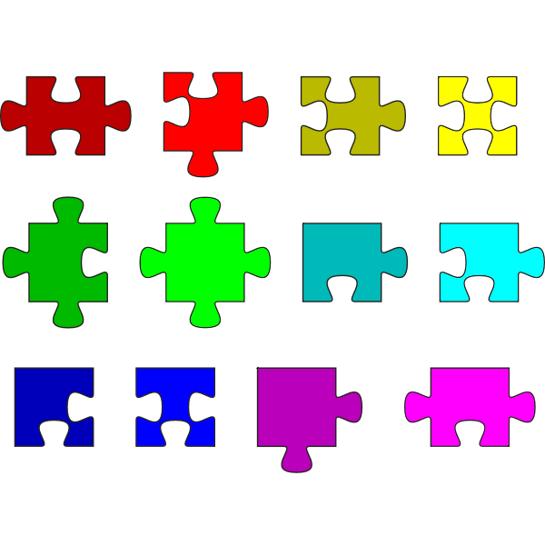
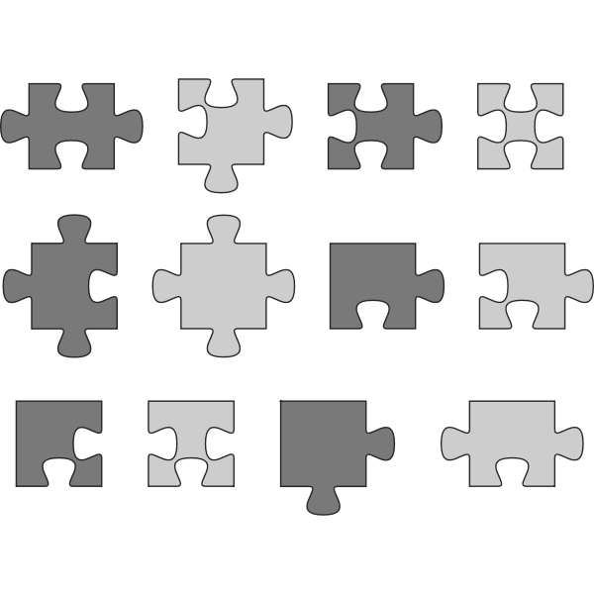





Open-Source
Stand on the shoulders of giants
Customizable
Community

Slide 22
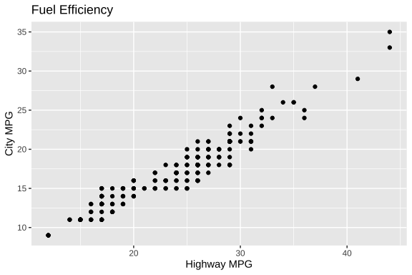
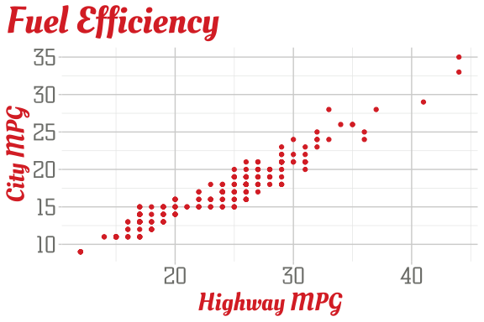
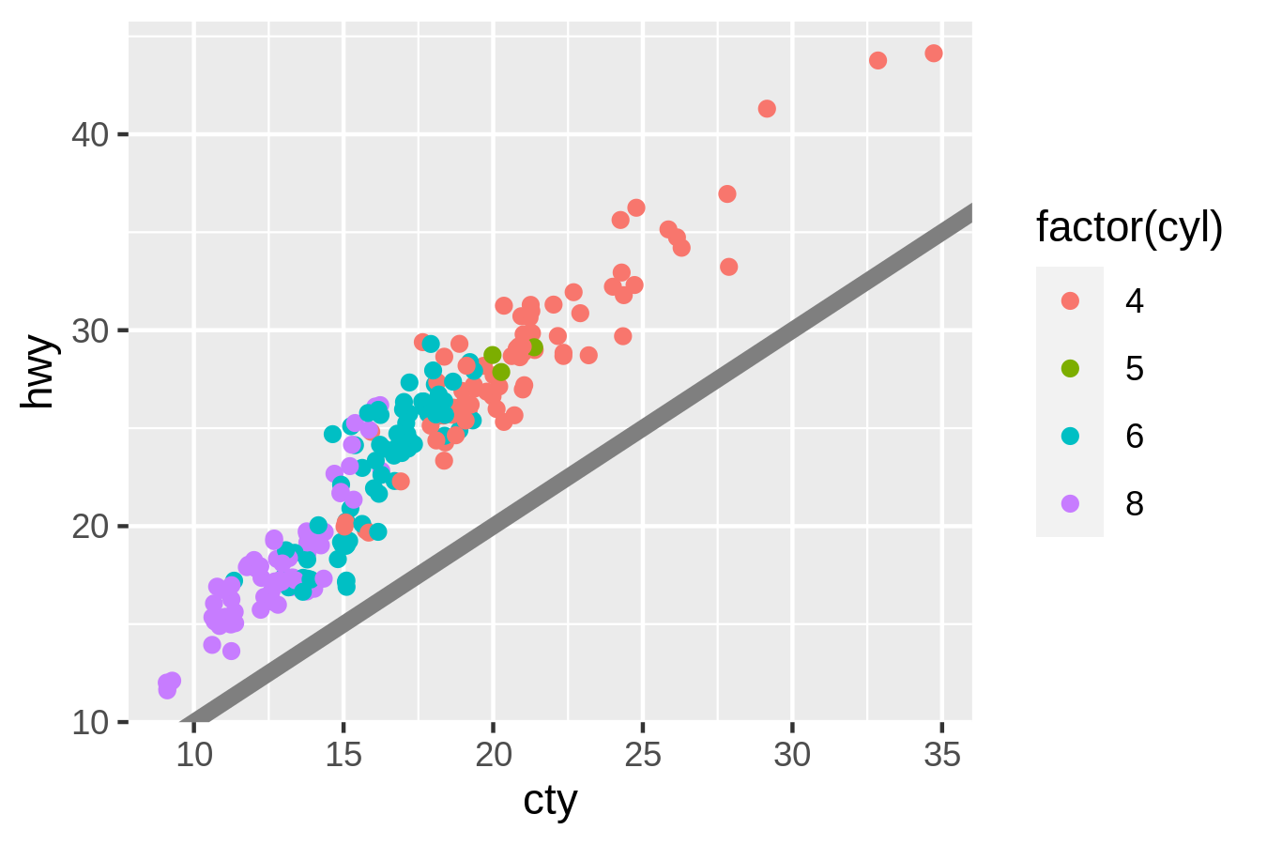
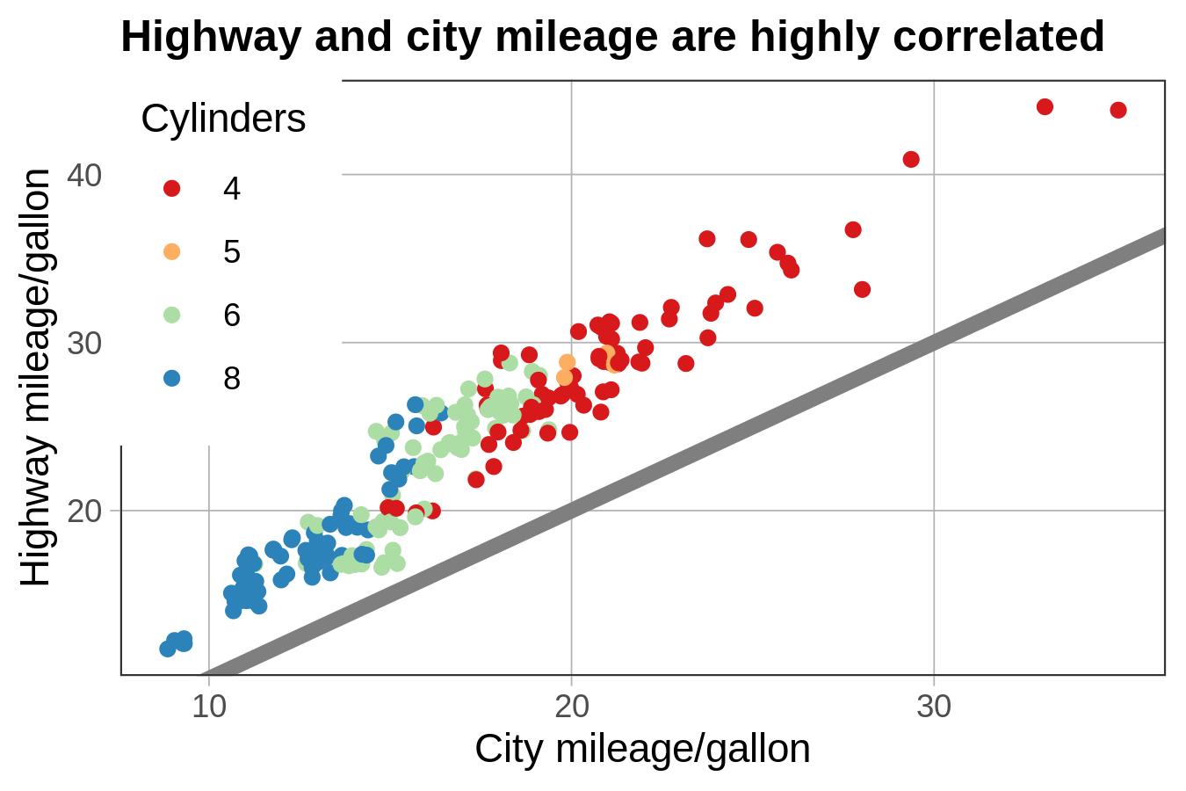
Open-Source
Stand on the shoulders of giants
Customizable
Community

Slide 23
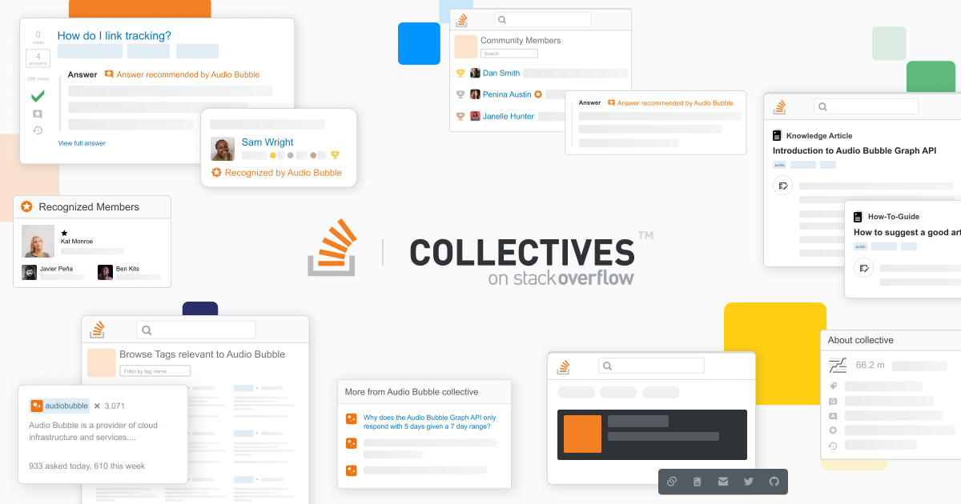
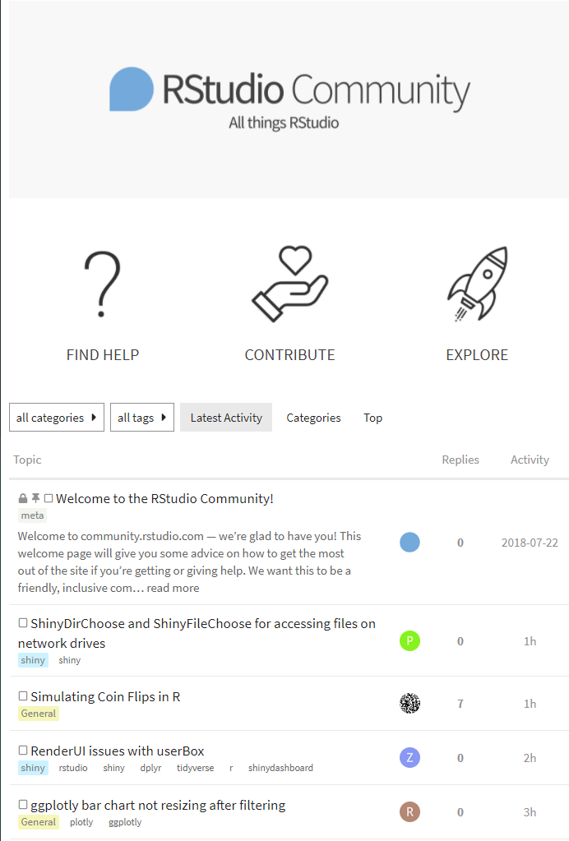
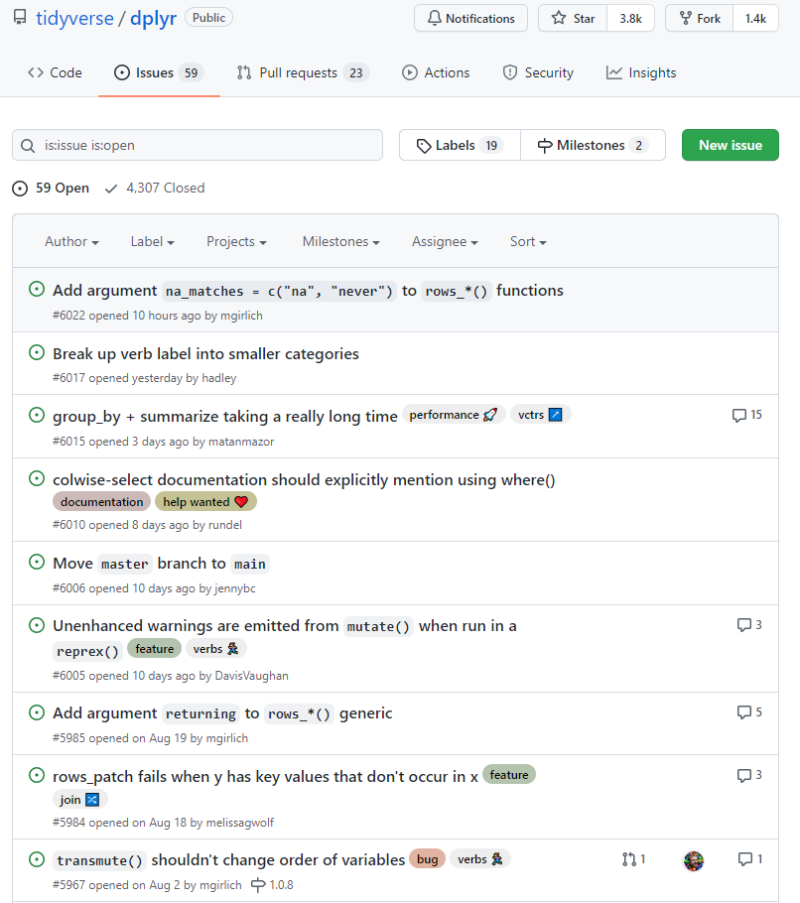
Open-Source
Stand on the shoulders of giants
Customizable
Community
Notes:
Better support
Known bugs are known and public

Slide 24
Build
Open-Source
Coding not a common skillset in laboratory personnel
"Risky" lab owns the continued maintenance
Coding not a common skillset in laboratory personnel
Notes:
Risk management
Fire
Strengths Weaknesses
Buy O the shelf solution without the need
for continued support by laboratory sta
• New system is just as likely to have gaps
• Laboratory is unlikely to receive support on par with that
from within the department
Build Fit for purpose custom solution with
potential to grow to evolve with the
laboratory
• Coding not a common skillset in laboratory personnel
• Laboratory “owns” the continued maintenance of the
soware to ensure

Slide 25
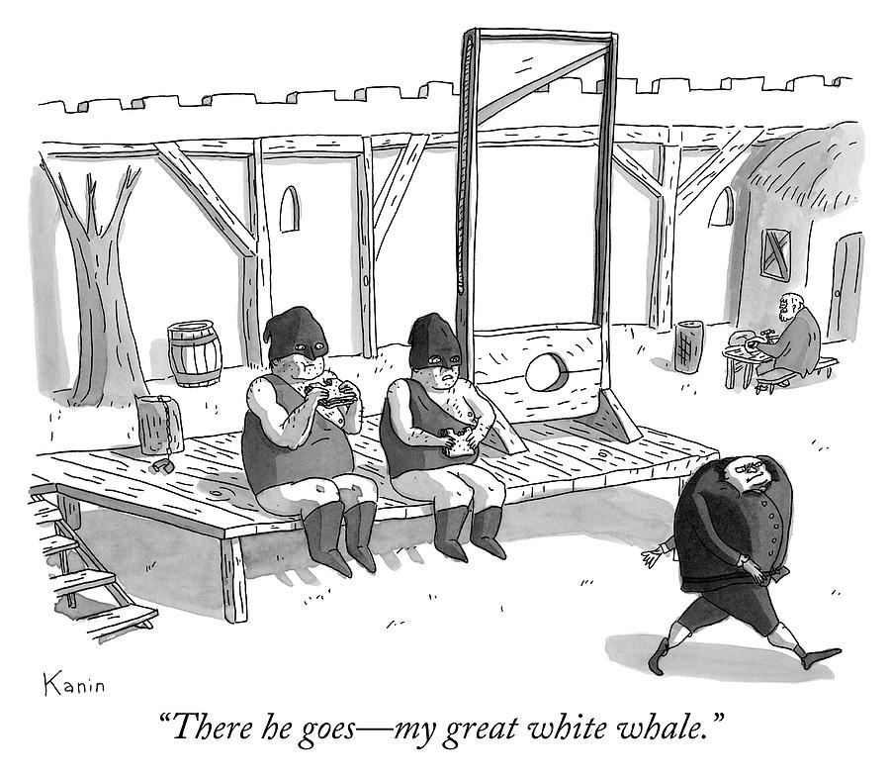
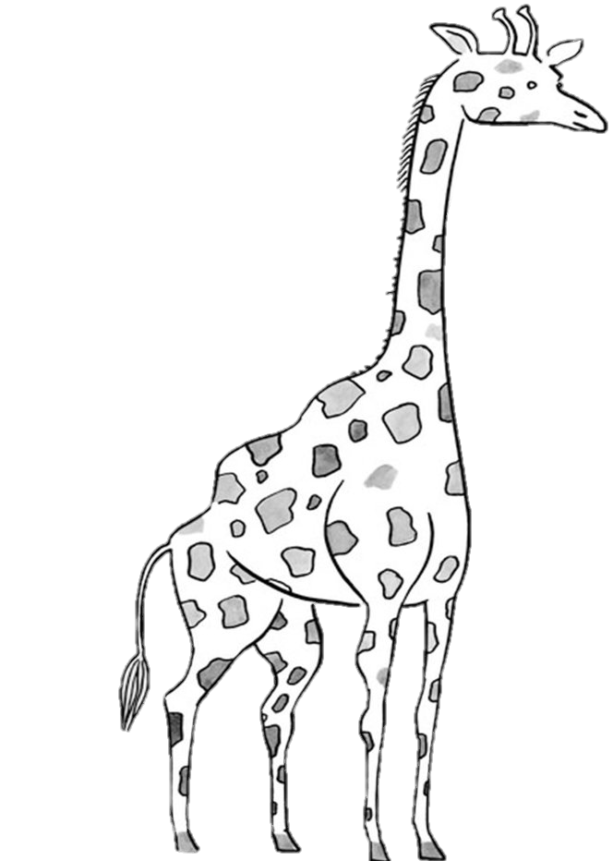

.
Notes:
Well as this guy on the lower right can tell you if you're not sticking your neck out you're not taking on much risk, but you're also not solving any problems either. The issue is that when you make a decision to improve the situation, you're more like this guy on the left ->
That's a bit more of a riskier proposition

Slide 26
Build
Open-Source
Coding not a common skillset in laboratory personnel
"Risky" lab owns the continued maintenance
Coding not a common skillset in laboratory personnel
"Risky" lab owns the continued maintenance
Software Engineering Practices
Notes:
Risk management
Fire
Strengths Weaknesses
Buy O the shelf solution without the need
for continued support by laboratory sta
• New system is just as likely to have gaps
• Laboratory is unlikely to receive support on par with that
from within the department
Build Fit for purpose custom solution with
potential to grow to evolve with the
laboratory
• Coding not a common skillset in laboratory personnel
• Laboratory “owns” the continued maintenance of the
soware to ensure

Slide 27
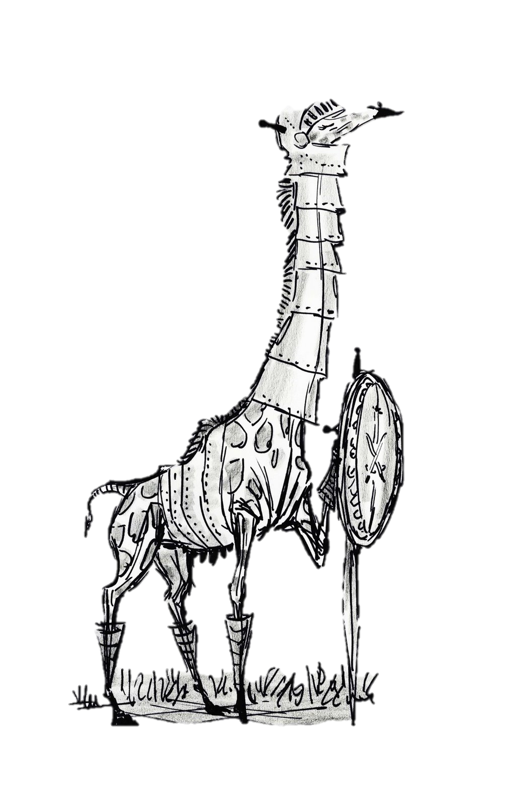
Software Engineering Practices
.
Notes:
Well as this guy on the lower right can tell you if you're not sticking your neck out you're not taking on much risk, but you're also not solving any problems either. The issue is that when you make a decision to improve the situation, you're more like this guy on the left ->
That's a bit more of a riskier proposition

Slide 28
Summary
Design gaps are inevitable in lab applications
01
Lab can buy or build solutions which offer automation and reproducibility
02
Building is easier and safer than most labs realize
03

